Slide 1

What-If Analysis For Residential Real Estate Data For New Jersey
Project 1
Submitted by:
Deborah Ofsievich
Jean Pino
Harmeet Kaur
Nitin Sharma

Slide 2

Rationale and Motivation

Slide 3



Slide 4



Slide 5


Slide 6
Objective
What is the ground reality ?
Which are the best and worst counties to live in NJ?
Is Crime and Education co-related?
Is School Rating corelated with Residential Real Estate Prices?
Is crime corelated with Residential Real Estate Prices?
Is Mass Transit (NJ Transit) co-related to Residential Real Estate Prices?

Slide 7

Methodology
County
Real Estate
Education
Mass Transit
Crime

Slide 8
Data Source
Dataset | Source
School data | schooldigger.com (API)
Crime data | NJSP.Gov
Real estate data | newjerseymls.com
Transit | NJ Transit (API)
Population | United States Census Bureau

Slide 9
Creating a master data frame
Percent of Crime, binning crime rate
Average standard score, group based on rank star, bar plot
School
Percent population
Population
Average price of 3 bedrooms
Real estate
Crime

Slide 10
Data Analysis Pipeline
Transit
School-Crime-Population-Resident
1.Gmap showing NJ transit stations
School-Crime-Population
Bar and scatter plots for:
1.Crime vs. avg. price
2.School score vs. avg. price
3.The top counties
4.The bottom counties
School-Crime
1.Donut plots
2.Scatter plot with regression analysis
1.Scatter plot with regression analysis

Slide 11
Challenges
Data exploration and cleaning
Data analysis
API call made to retrieve records from multiple pages.
One Station was tagged to multiple Stations. Had data for Light rails and path.
No real estate data for south of New Jersey
Data could not be merged based on common key.
ValueError while filling 0 for null values.
Commas in numerical values are treated as strings

Slide 12
Results

Slide 13
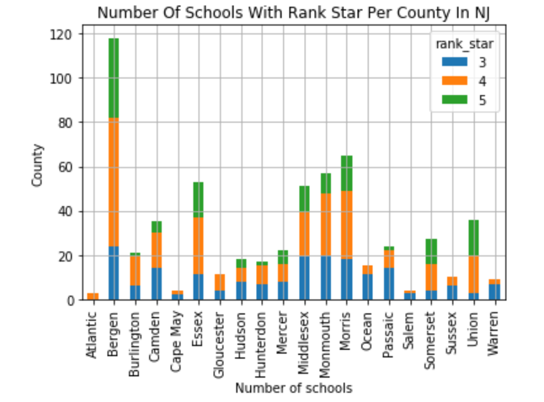
Analysis of School data
Bergen County is Best School District in NJ
Salem is Worst School District in NJ

Slide 14
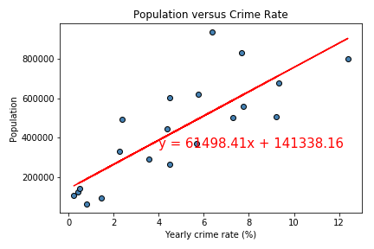
Crime Vs Population
There is direct relationship between Population and Crime. As the Population go up the Crime rate also goes up exponentially
R-squared value:0.80

Slide 15
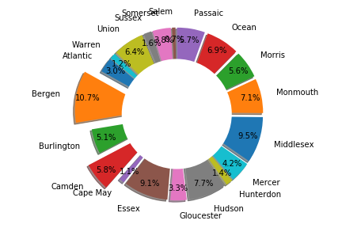
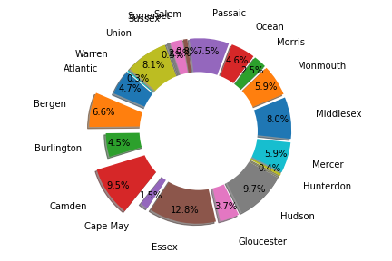
% Population Vs % Crime
% Population
% Crime
Bergen County has 10.7 % of total Population but only 6.6 % to total crime
Camden has only 5.8 % of population but 9.5 % of total Crime

Slide 16
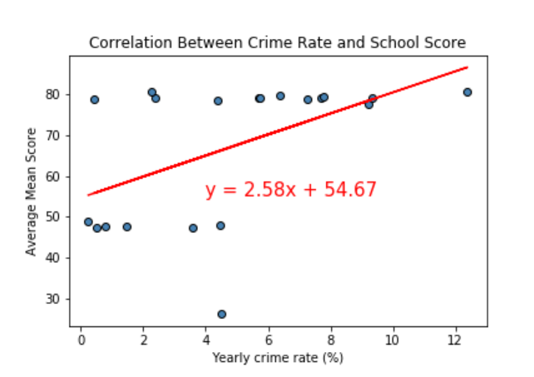
Crime Vs Education
There is a indirect co-relation between education and Crime as the Level of Education goes up Crime Rate goes down
R-squared value:0.50

Slide 17
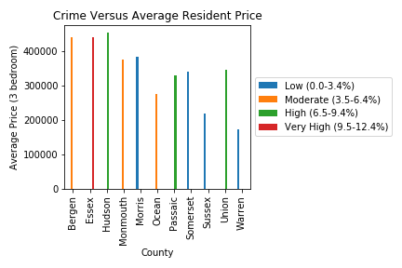
% Crime versus Residential Rate

Slide 18
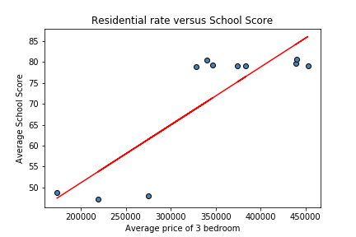
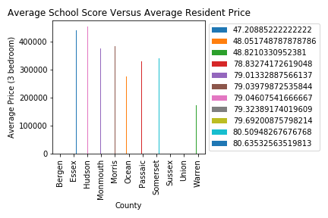
School Score versus Residential Rate
There is a co-relation Average School Score and residential prices
R-squared value:0.58

Slide 19
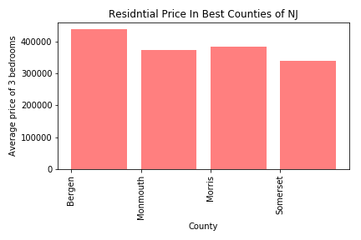
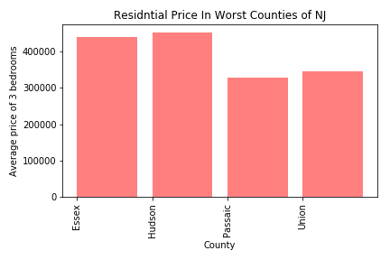
Residential price in counties based on school score and crime rate
Residential price in counties with high school score and low crime rate
Residential price in counties with low school score and high crime rate

Slide 20
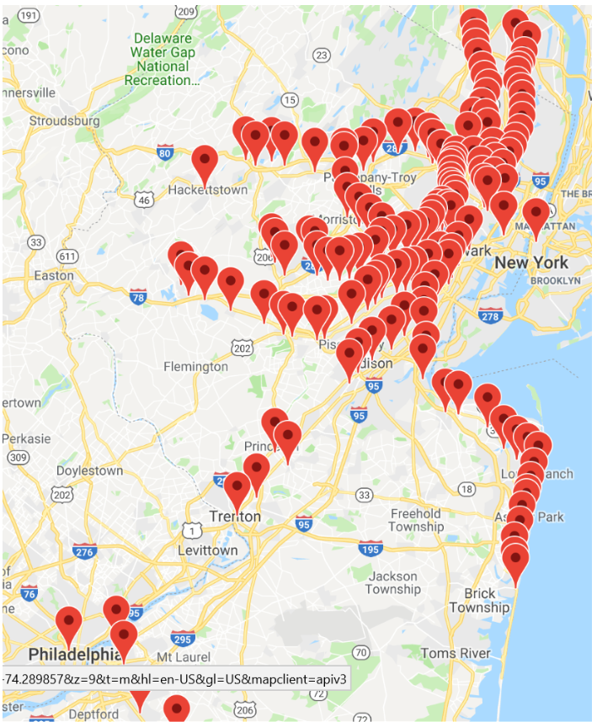
MASS TRANSIT

Slide 21
Conclusion
Best County to Live in: Bergen, Monmouth
Worst County to Live in: Camden, Passaic
Residential Prices seem to have (-Ve) co-relation with Crime as evident from correlation coefficient
Residential Prices seem to have co-relation (+ Ve) with Education as evident from correlation coefficient
5. Does RE Prices have correction with Mass Transit

Slide 22
Limitations
Real estate data was not available for all counties, comparison the sample size.
Study at the zip code level would have provided accurate correlations between the metrics affecting residential price

Slide 23
Thank you

Slide 24
?

